Slide 1
SMART SALON APPLICATION
by MINH HOANG TRAN

Slide 2
Smart Salon Application
Date: 4/25/2025
Student Name: MINH HOANG TRAN
Major: Cybersecurity
Degree: BACHALOR Degree in Cybersecurity
Project Advisor: PROF. JULIE HENDERSON

Slide 3
Statement of Purpose
Problem: Salon desktop application are:
High cost for many salon owners
Using pen-and-paper methods, which are time-consuming, prone to errors, and inefficient.
Purpose:
Free, secure, and user-friendly Salon POS system.
Help minimize check-in mistakes.
Improve employee management.
Notes:
Problem: Salon desktop applications are often too expensive for many salon owners.
This leads them to use traditional pen-and-paper methods, which are time-consuming, prone to errors, and inefficient.
Goal: Create a free, secure, and user-friendly salon management desktop application to simplify salon operations, minimize scheduling mistakes, and enhance financial management. Features like password protection and role-based access control ensure data privacy and security.

Slide 4
Research & Background
While doing research in for Salon management applications, the currently available on the market come with high costs, making them inaccessible to small business owners.
By researching existing salon management software, security policies, and cybersecurity best practices, this project aims to create a free and secure alternative.

Slide 5
Project Language(s), Software, and Hardware
Programming Languages: JavaScript, Node.js, Bash
Software Tools: SQLite for database management, Node JS for GUI development, GitHub for version control. Electron.js cross-platform application.
Hardware: Standard desktop or laptop computer with Windows

Slide 6
Project Requirements
Functional:
Allow worker and admin to login.
Input customer information.
Calculate the total money of service.
Print receipt.
Print employee information.
Look and Feel.
Usability.
Performance.
Maintainability and Support.
Security.
Full Project Requirement can be found Here.

Slide 7
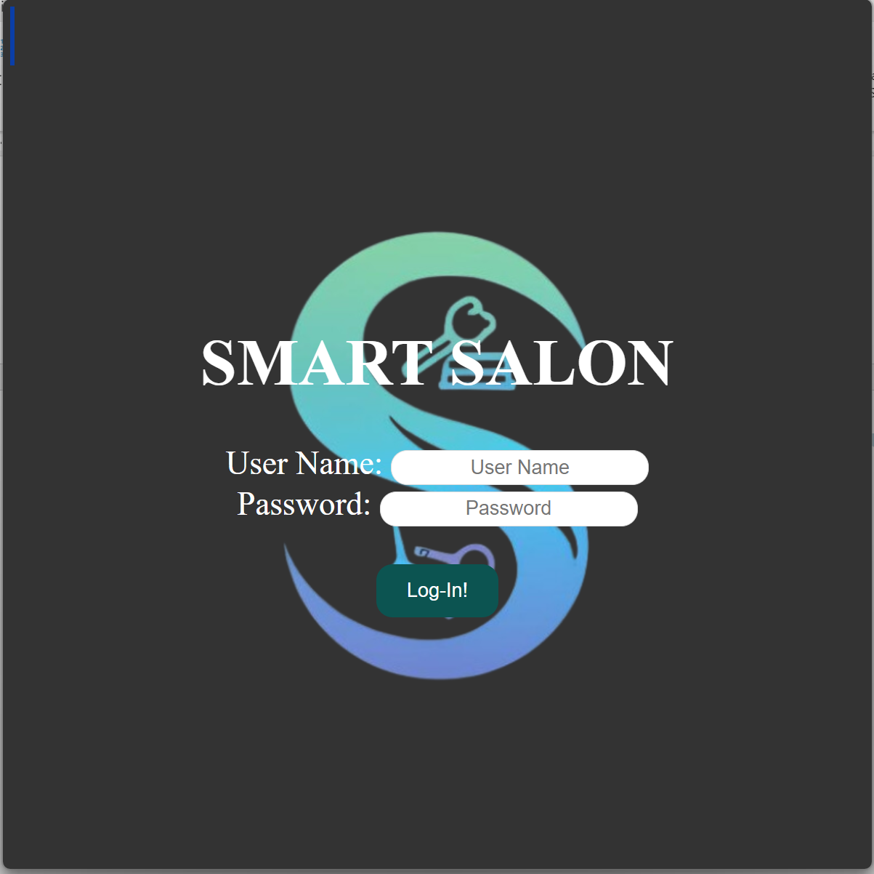
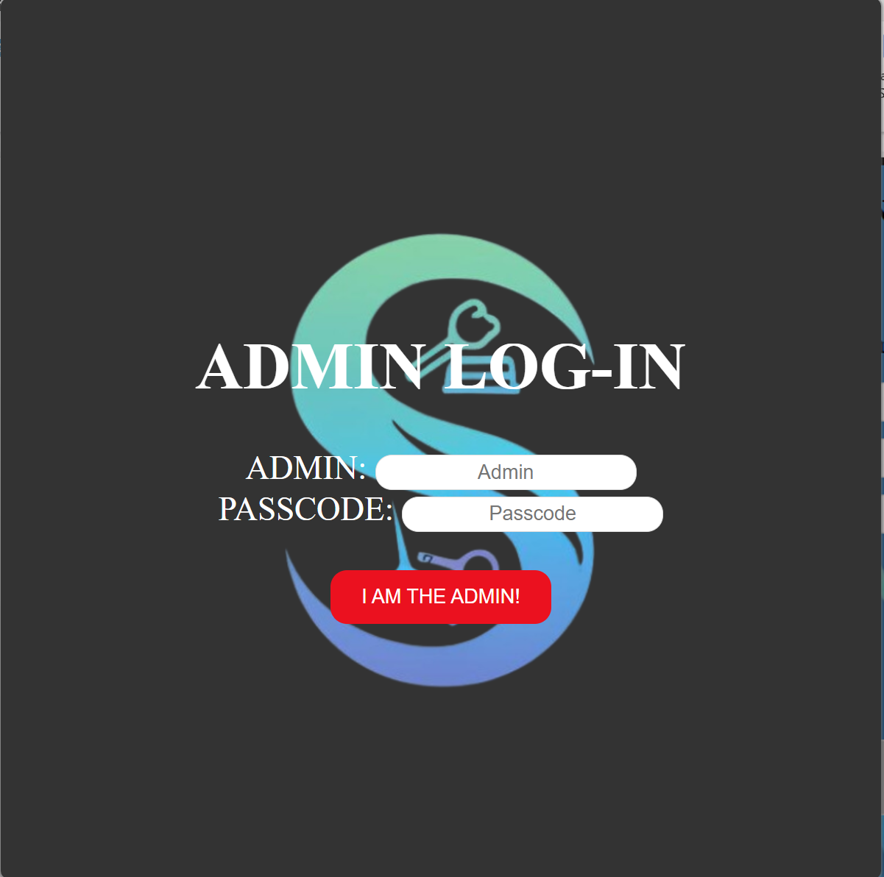
Project Implementation Description & Explanation
Fig 1. User log-in
Fig 2. Admin log-in

Slide 8
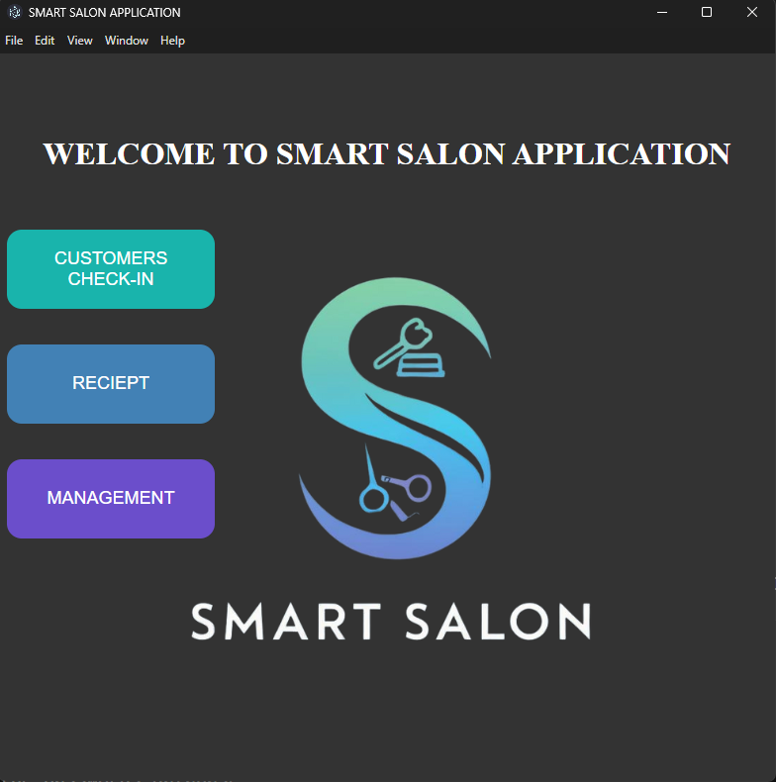
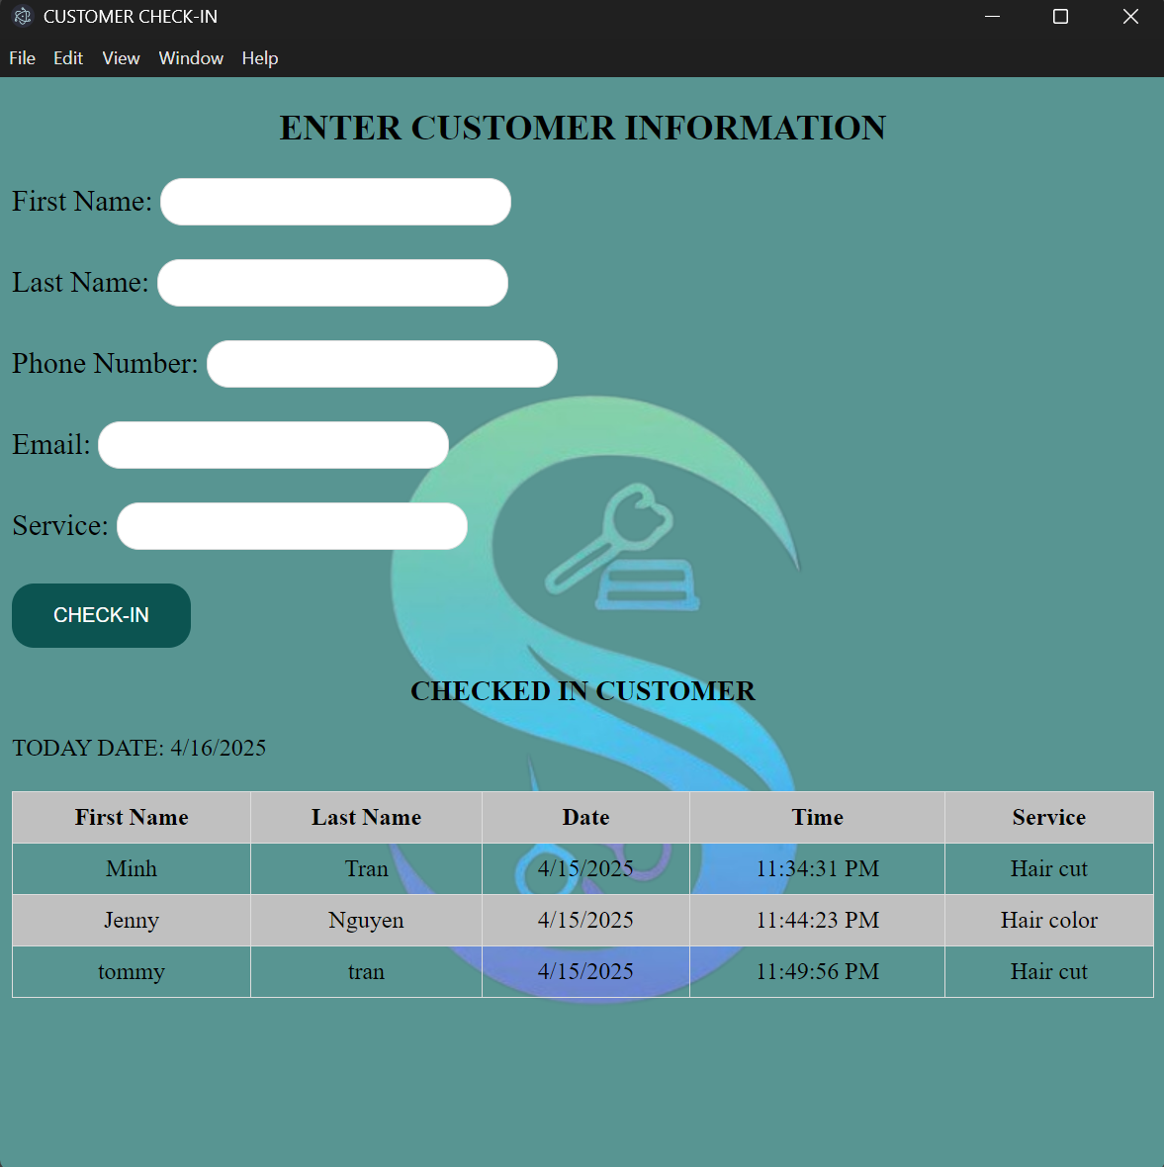
Project Implementation Description & Explanation
Fig 3. Main screen of the app
Fig 4. Admin log-in

Slide 9
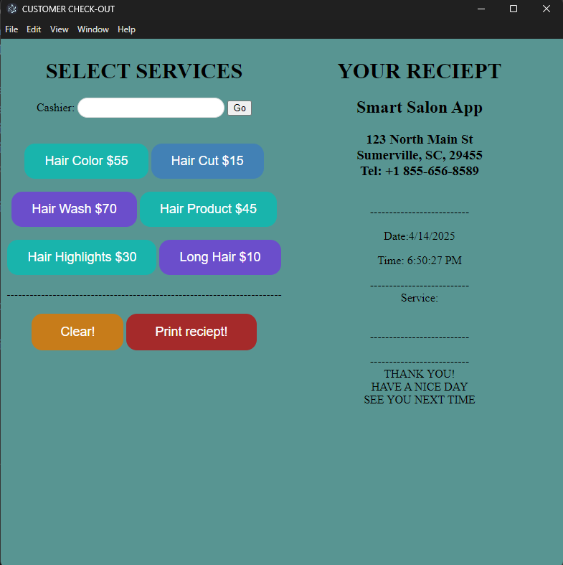
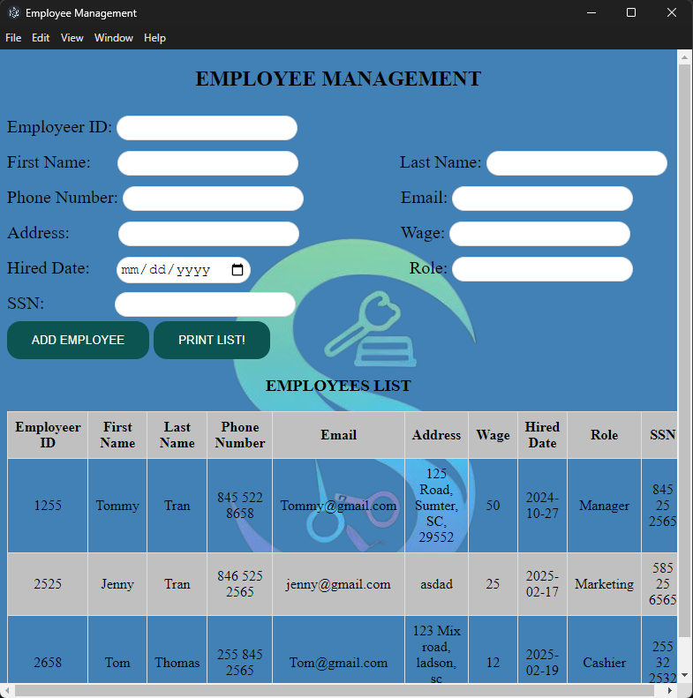
Project Implementation Description & Explanation
Fig 5. Print Receipt
Fig 6. Management
Link for source code is HERE.

Slide 10
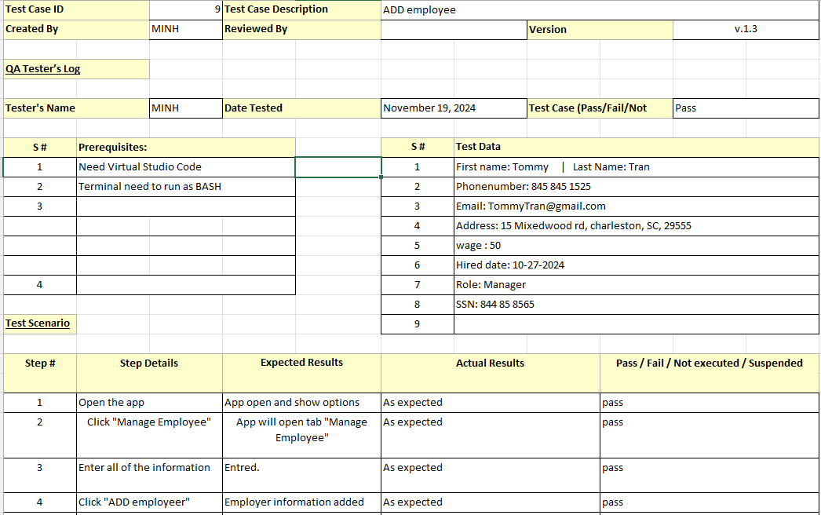
Test Plan & Results
Full test results can be found here.
Fig 7. Test case Template.

Slide 11
Security Policies
Acceptable Use Policy.
Data Breach Response.
Ethic Policy.
Password Protection Policy
System Security Plan
Full detail security policies can be found HERE.

Slide 12
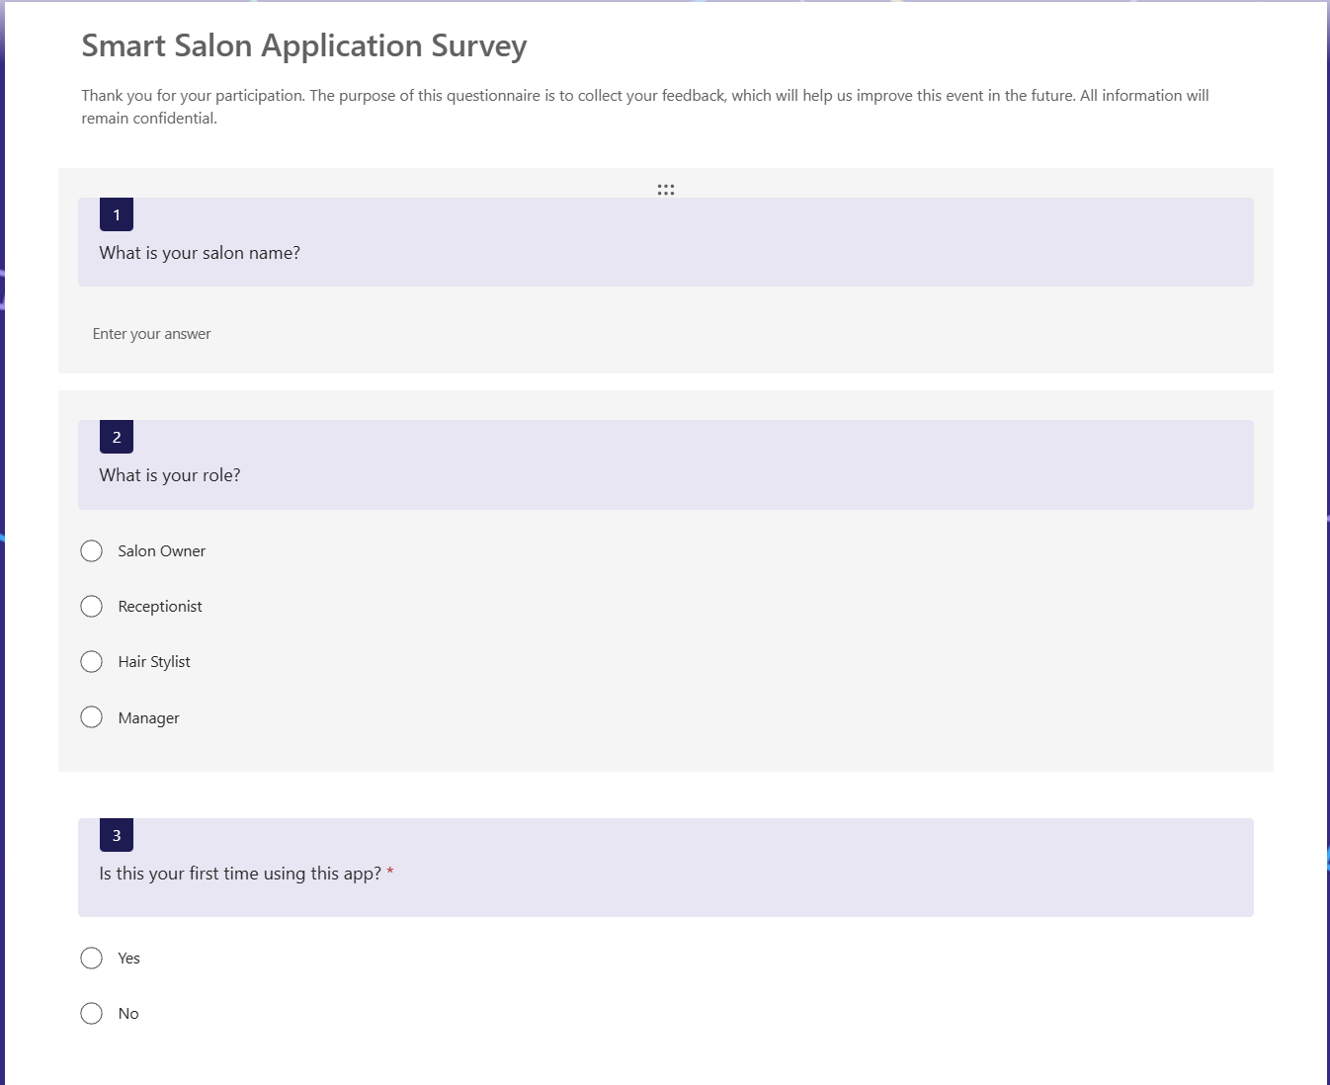
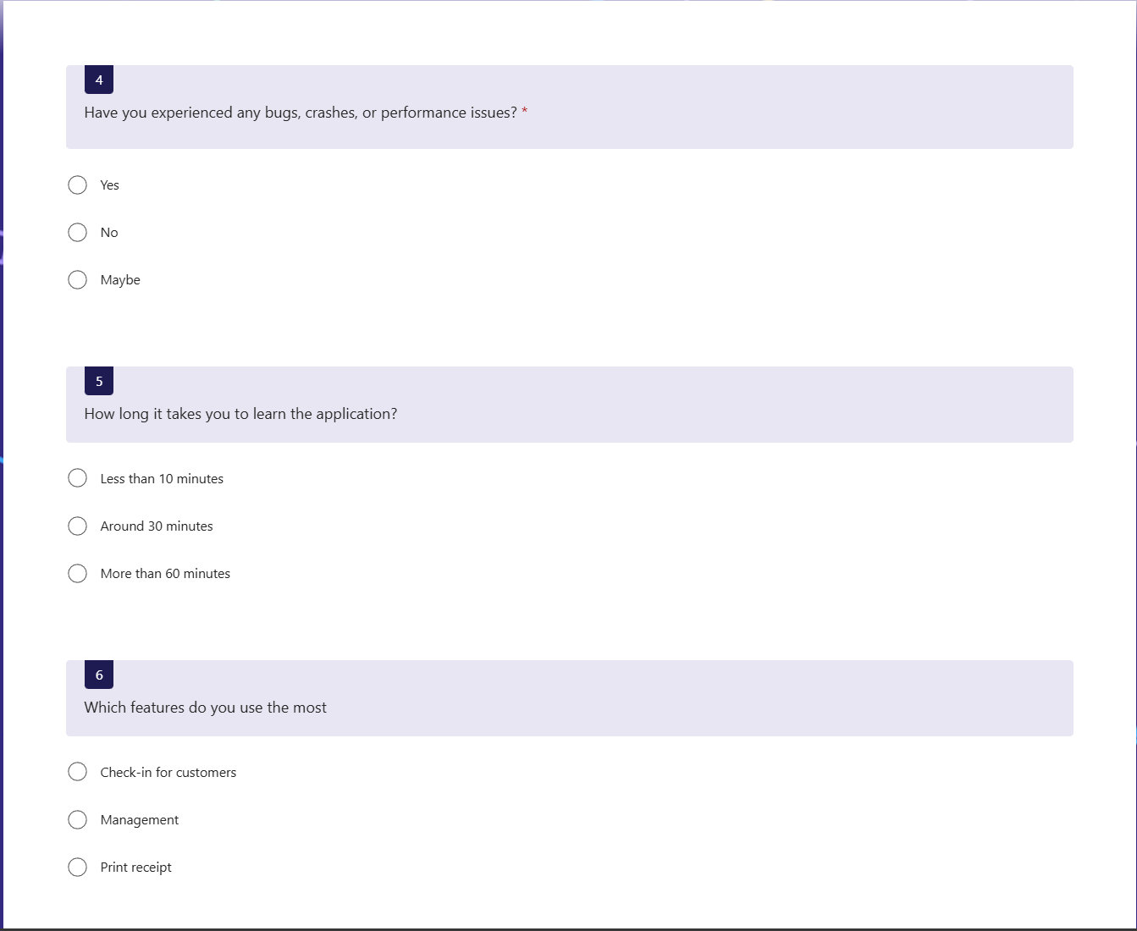
Survey Questions
Full survey questions can be found HERE.
Survey results can be found HERE.

Slide 13
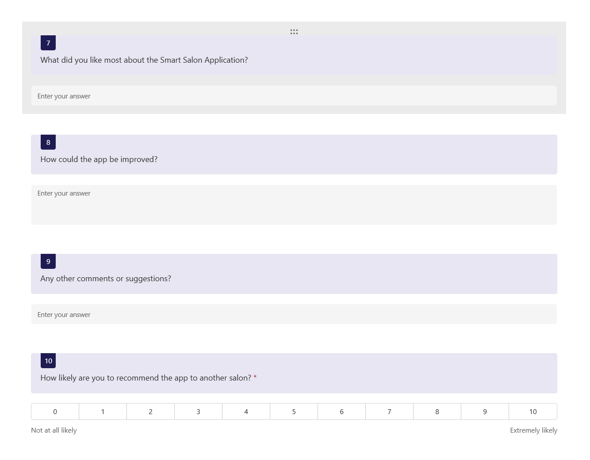
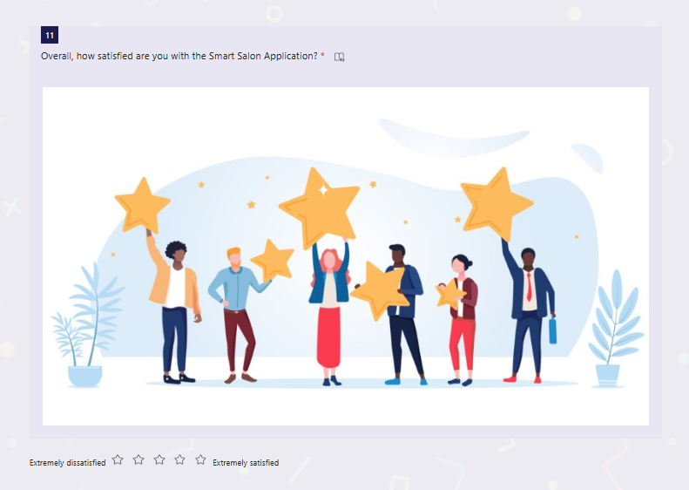
Survey Questions
Survey results can be found HERE.
Full survey questions can be found HERE.

Slide 14
Challenges Overcome
1. Challenge: How to make this application work on both IOS and Desktop devices?
Solution: Did research and find out Electron and Node.js to help build cross-platform.
2. Challenge: Don’t know where to store the data.
Solution: Using SQLite to save data in local database. Cost effective, and fast performance.
3. Challenge: Create an easy and neat user interface
Solution: Doing research on other application, design and create logo, color theme.

Slide 15
Future Enhancements
Create appointment book.
Connect this app to check-out machine.
Cloud storage for backup and remote access.
Create function to reset all data.
Change theme color of the application.

Slide 16
Thank you

